Slide 1
Object-Oriented Analysis and Design
References - - - - - - - - Bruegge B., and Dutoit A. H. 2010, Object-oriented Software Engineering using UML, Patterns and Java, 3rd ed., Prentice Hall

Slide 2
The object model
Foundations
Object model is influenced by many factors, not just object-oriented programming. e.g. design of user interfaces, databases, and computer architectures.
An object – maintains integrity and there exist invariant properties that characterize an object and its behavior.
Objects cooperate with other!

Slide 3
The object model
Object-oriented programming (OOP)
A method of implementation in which programs are organised as cooperative collections of objects.
Three features;
OOP uses objects, not algorithms, as its fundamental building blocks (‘has a’);
Each object is an instance of some class; and
Classes may be related to one another via inheritance (‘is a’). (no inheritance → abstract data types, e.g. stack)

Slide 4
The object model
Object-oriented programming (OOP)
A language is object-oriented if and only if it satisfies the following requirements :
It supports objects that are data abstractions with an interface of named operations and a hidden local state.
Objects have an associated type [class ].
Types [classes ] may inherit attributes from supertypes [superclasses ].

Slide 5
The object model
Object-oriented design (OOD)
A design method encompassing the process of object-oriented decomposition and a notation for depicting both logical and physical as well as static and dynamic models of the system under design.
Design
Notation

Slide 6
The object model
Object-oriented analysis (OOA)
A method of analysis that examines requirements from the perspective of the classes and objects found in the vocabulary of the problem domain.
OOA → OOD → OOP

Slide 7
The object model
Elements of object model
Abstraction – essential characteristics
Encapsulation – compartmentalizing the elements of an abstraction that constitute its structure and behavior
Modularity – system decomposed into cohesive and loosely coupled modules
Hierarchy – inheritance, multiple inheritance, avoid redundancy

Slide 8
The object model
Elements of object model
Typing – precise characterisation of structural or behavioral properties (enforcement of the class of an object), static typing, dynamic typing (polymorphism)
Concurrency – active object can be distinguished from one that is not active
Persistence – state and class of an object is consistent across time or space

Slide 9
The object model
Benefits
Expressive – real world objects and their interactions are better expressed using OM
OM encourages reuse
Modular design allows resilient change

Slide 10
Classes and objects
Real-world consists of objects
An object
A tangible and/or visible thing
Something that may be comprehended intellectually
Something toward which thought or action is directed

Slide 11
objects
An object
Has state – static properties and current properties (dynamic)
Has well-define behavior – how object acts and reacts in terms of its state changes and message passing (operations: modifier, selector, iterator, constructor, destructor; roles and responsibilities)
Has a unique identity – every object should be distinguishable from other objects

Slide 12
objects
Relationship among objects
Two types
Links – physical/conceptual connection between two objects (peer-to-peer or client/supplier)
Aggregation – whole/part hierarchy

Slide 13
objects
Relationship among objects
Links – show message passing
While passing message, an object may play one of three roles;
Controller
Server
Proxy (both controller and server, represents a real-world object in the domain of the application)

Slide 14
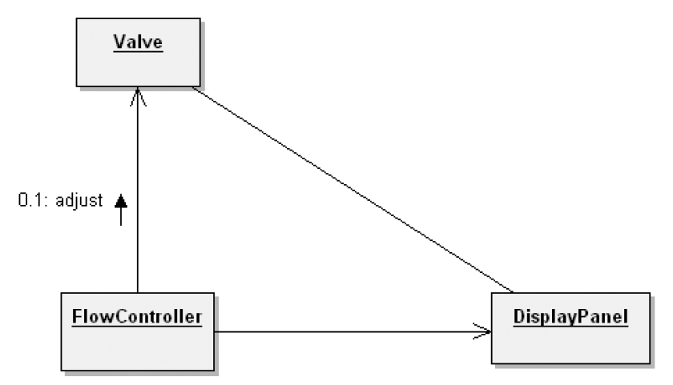
objects
Relationship among objects
Links – show message passing
Notes:
Fig. OOAD #001

Slide 15
objects
Relationship among objects
Links
Visibility - for an object to receive messages, it must be visible to others.
Synchronisation – objects may be active in sequence, guarded (mutual exclusion), or concurrent

Slide 16
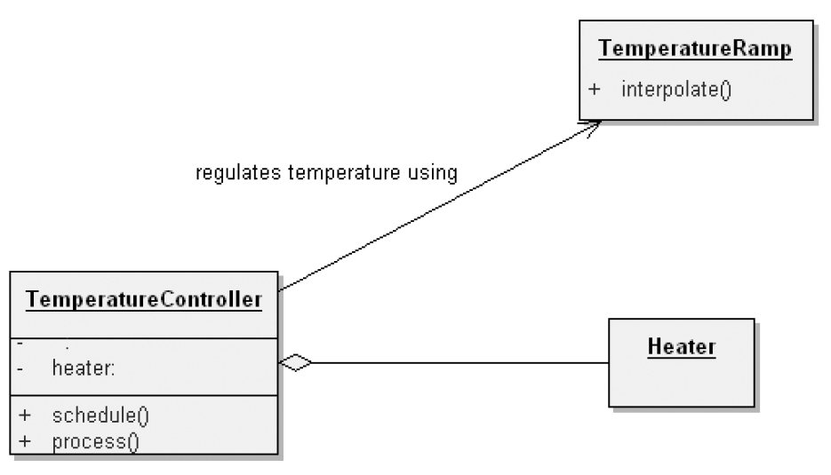
objects
Relationship among objects
Aggregation – whole/part hierarchy
Notes:
Fig. OOAD #002

Slide 17
Classes
Classes provide framework for objects
An object is an instance of a class.
A class represents a set of objects that share common structure and a common behavior.

Slide 18
Classes
Interface of a class
Public – components of a class accessible to all clients)
Protected – accessible to itself and its subclasses
Private – accessible to itself
Package – accessible by classes in the same package

Slide 19
Classes
Relationship among classes
Association
Semantic dependencies – e.g. a weather station has multiple sensors.
Multiplicity – one-to-one, one-to-many, many-to-many
Inheritance – a class may inherit a super-class
Single inheritance
Polymorphism
Multiple inheritance

Slide 20
Classes
Relationship among classes
Aggregation - whole and part relationship (has a), enforces physical containment
Dependencies – when one element is dependent on other, e.g. one module dependent on other.

Slide 21
Interplay of classes and objects
Identify the classes that form the vocabulary of the problem domain.
Invent the structures whereby sets of objects work together to provide the behaviors that satisfy the requirements of the problem.

Slide 22
Building quality classes and objects
Measuring quality of abstraction –
Coupling,
Cohesion,
Sufficiency,
Completeness,
Primitiveness
Choosing operations
Functional semantics – focusing on reusability, complexity, applicability and implementation performance
Time and space semantics

Slide 23
Building quality classes and objects
Choosing relationships
Law of demeter – the methods of a class should not depend on structure of other classes, except its immediate super class.
Visibility
Implementation
Proper representation
Proper packaging

Slide 24
Proper classification
Classification helps generalisation, specialisation, aggregation hierarchies among classes.
Objects, classes, hierarchies, associations etc. need to properly identified.
Help maintain proper level of cohesion and coupling.
Challenges – there is no perfect classification, intelligent classification requires tremendous amount of creative insight

Slide 25
Identifying classes and objects
Three approaches to classification;
Classical cetegorisation - All the entities that have a given property or collection of properties in common form a category. Such properties are necessary and sufficient to define the category. e.g. employee
Conceptual clustering – classes are generated by formulating conceptual descriptions then classifying the entities according to the descriptions. e.g. love songs
Prototype theory – class represented by prototypical object e.g. game

Slide 26
Object-oriented modeling
Object-oriented perspective
Basic building block of a software system is the object or class.
Object is a thing.
Class is a set of common objects.
Every object has;
Identity (name)
State (properties/data associated)
Behavior (methods)

Slide 27
 |  | Process segments
 |  | Requirements | Analysis | Design | Development | Deployment
UML diagrams | Use case diagram | Sponsor objectives | Conceptual model
 | Class diagram |  | Conceptual level classes | Specification level classes | Implementation level classes
 | Object diagram |  | Identify objects | Identify objects
 | State diagram |  | Object behavior
 | Sequence diagram |  | Object interaction
 | Collaboration diagram |  | Object interaction
 | Activity diagram | User operation(s) |  | System operations
 | Component diagram |  |  | Visualise components
 | Package diagram | System requirements
 | Deployment diagrams | System elements | System integration | System integration

Slide 28
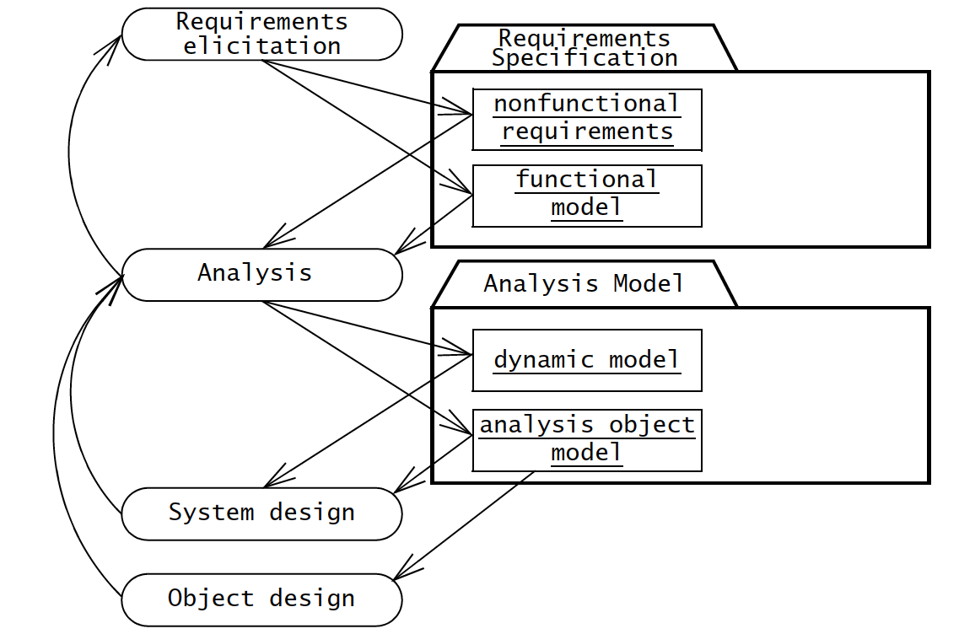
Requirements elicitation and analysis

Slide 29
Requirements elicitation activities
Identify actors
Identify scenarios
Identify use cases
Refine use cases
Identifying relationships among use cases
Identifying nonfunctional requirements
Source of information
Client-supplied documents
Manuals
Technical documentation of legacy systems
End-user discussions

Slide 30
Nonfunctional requirements
Broad variety of requirements that are not related to functional behavior of the system
FURPS+ model suggests following categories of nonfunctional requirements
Usability
Reliability
Performance
Supportability

Slide 31
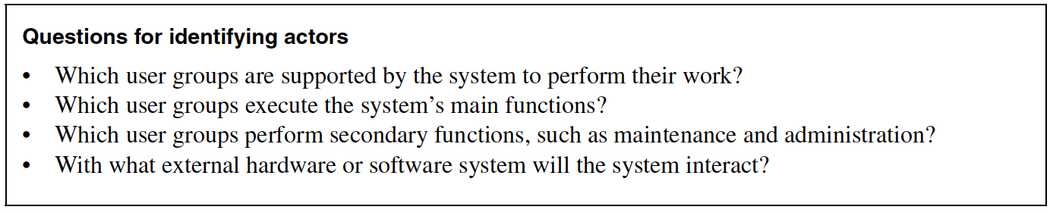
Identifying actors
Nouns that initiate/trigger events

Slide 32
Identifying scenarios
Concrete, focused, informal description of a single feature of the system from viewpoint of a single actor

Slide 33
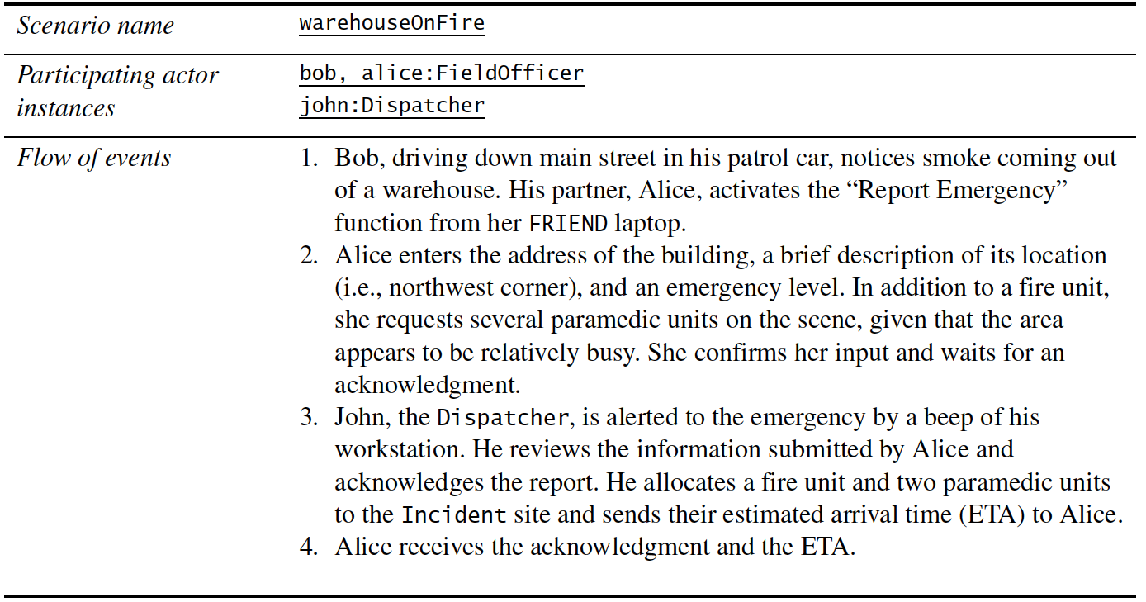
Identifying scenarios

Slide 34
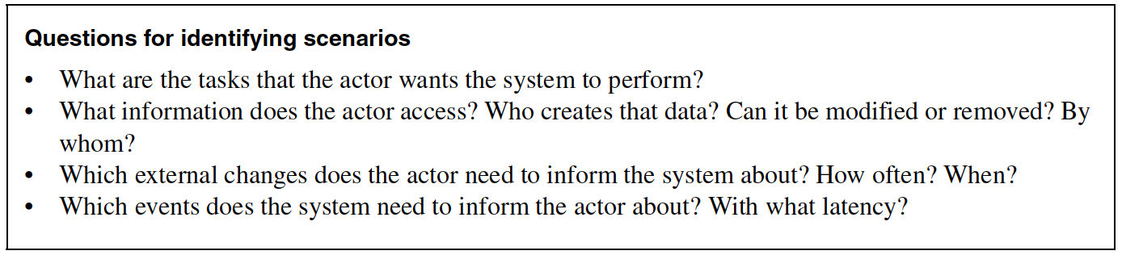
Identifying scenarios

Slide 35
Identifying use cases
Use cases represent all possible scenarios for given piece of functionality
A use case is initiated by an actor
A use case may interact with other actors
Name of a use case – should be a verb phrase

Slide 36
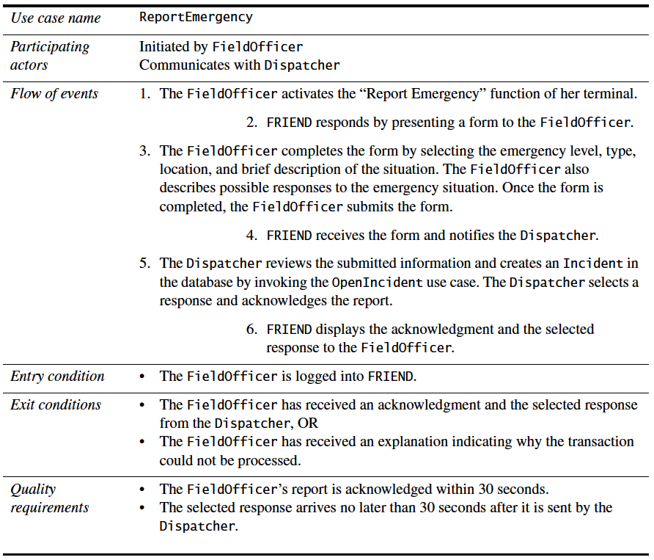
Another example

Slide 37
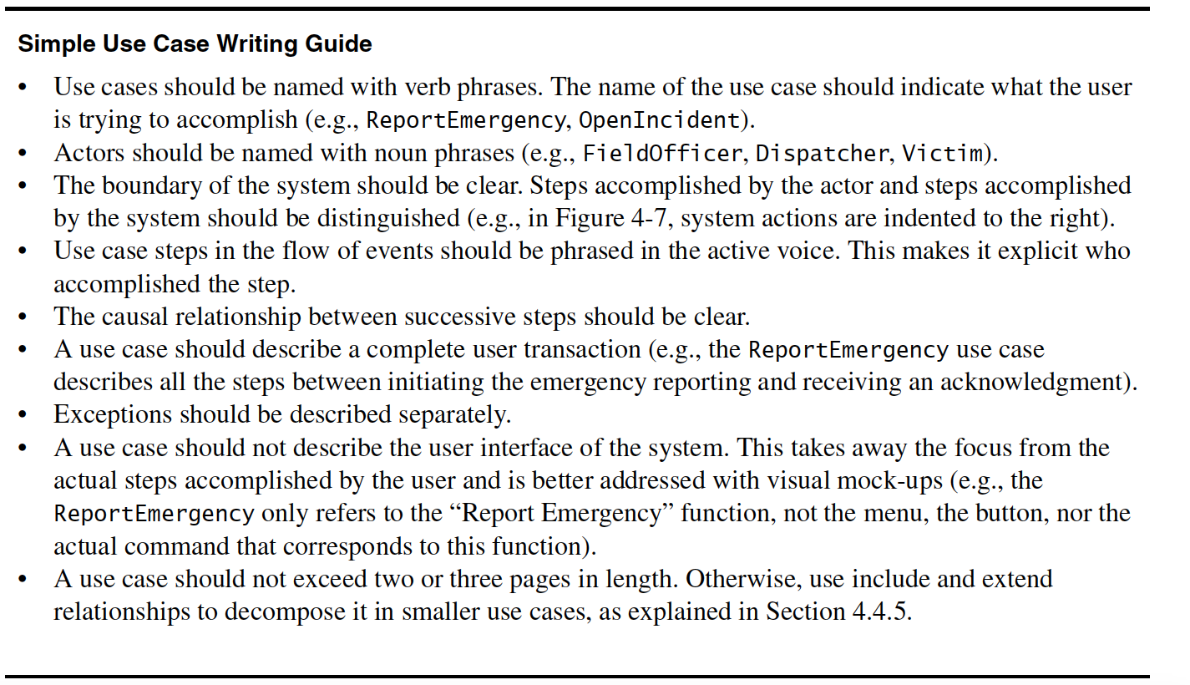

Slide 38
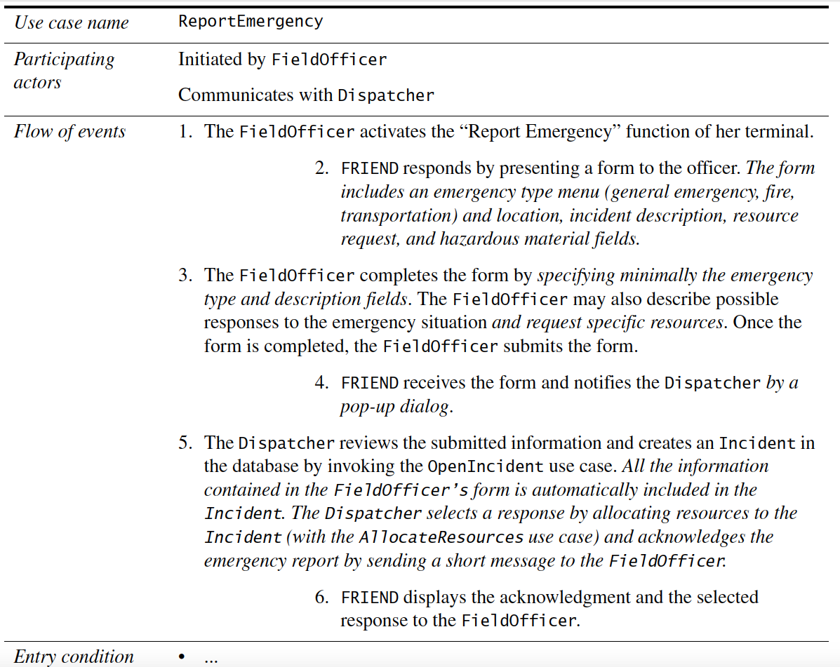
Refining use cases

Slide 39
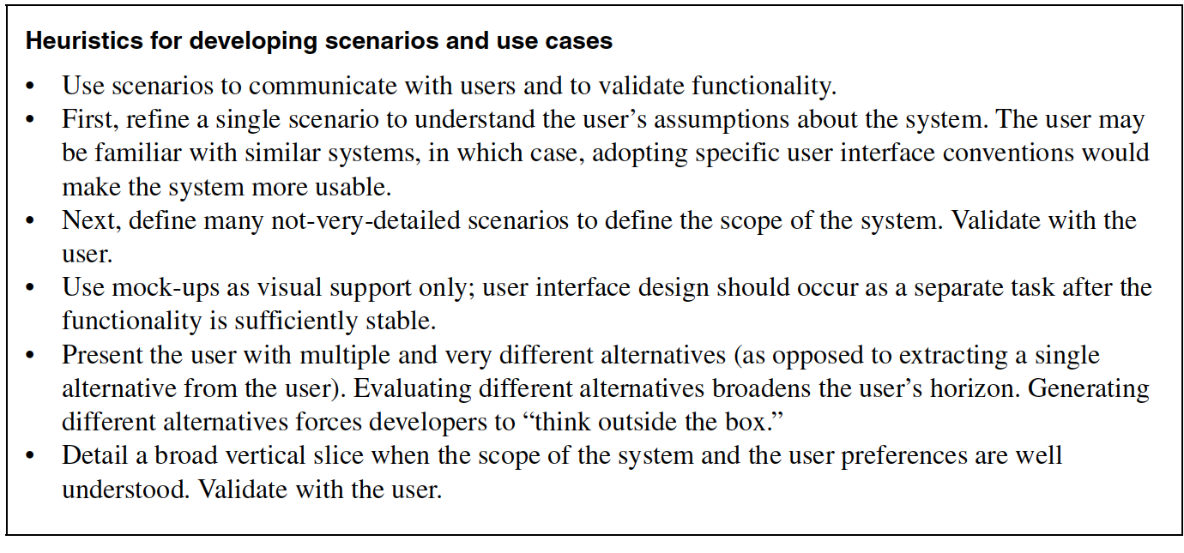

Slide 40
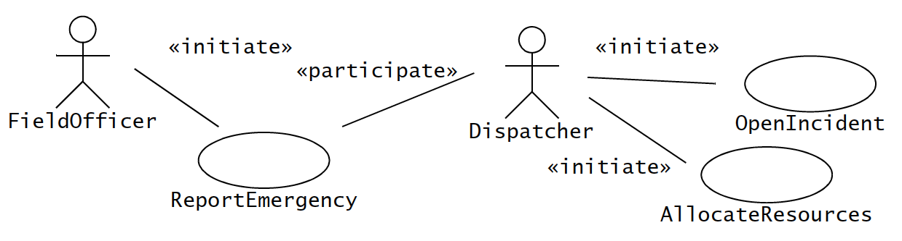
Identifying relationships between actors and use cases
Communication relationships between actors and use cases
Actor who initiates the use case should be distinguished from other actors

Slide 41
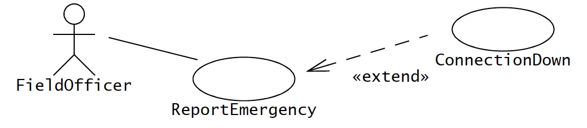
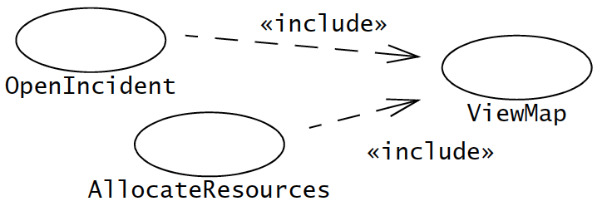

Slide 42
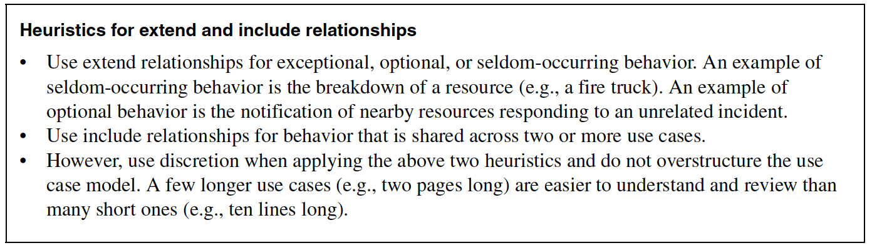

Slide 43
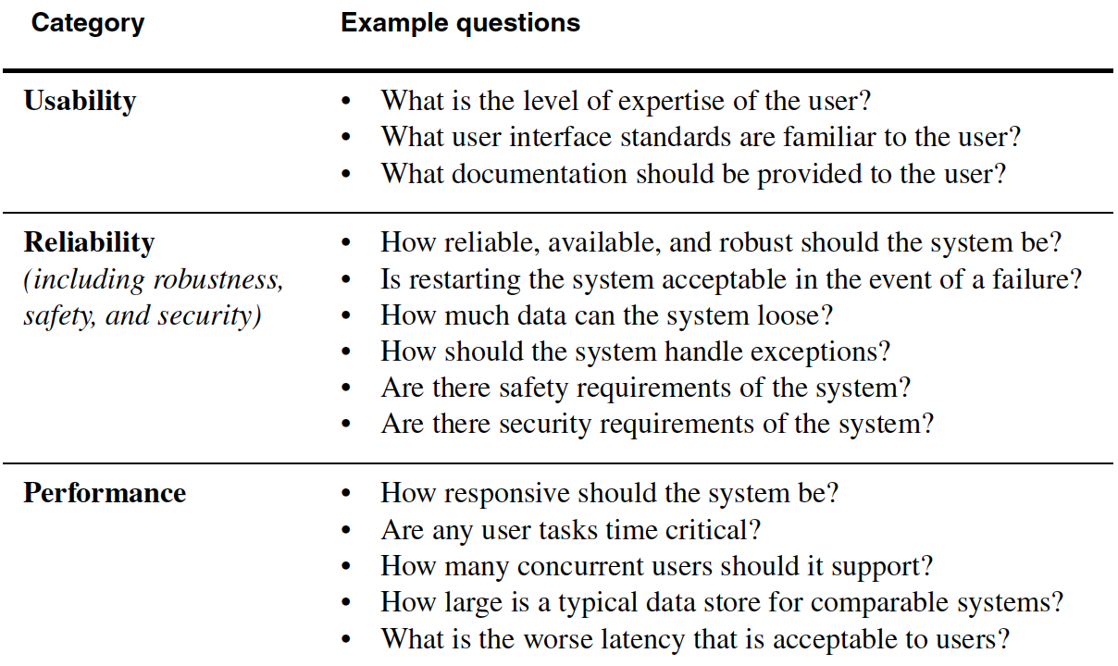
Identifying nonfunctional requirements

Slide 44
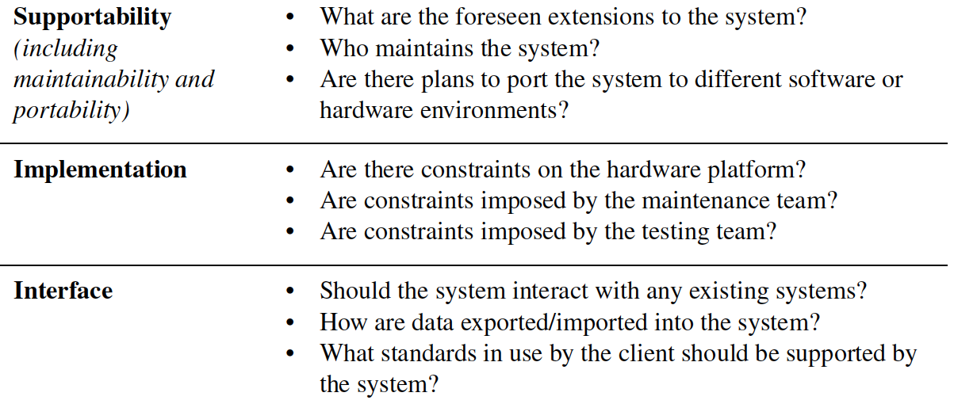
Identifying nonfunctional requirements

Slide 45
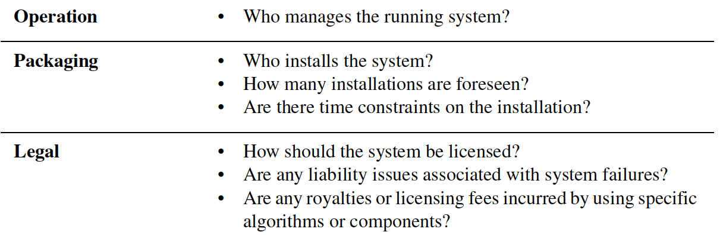
Identifying nonfunctional requirements

Slide 46
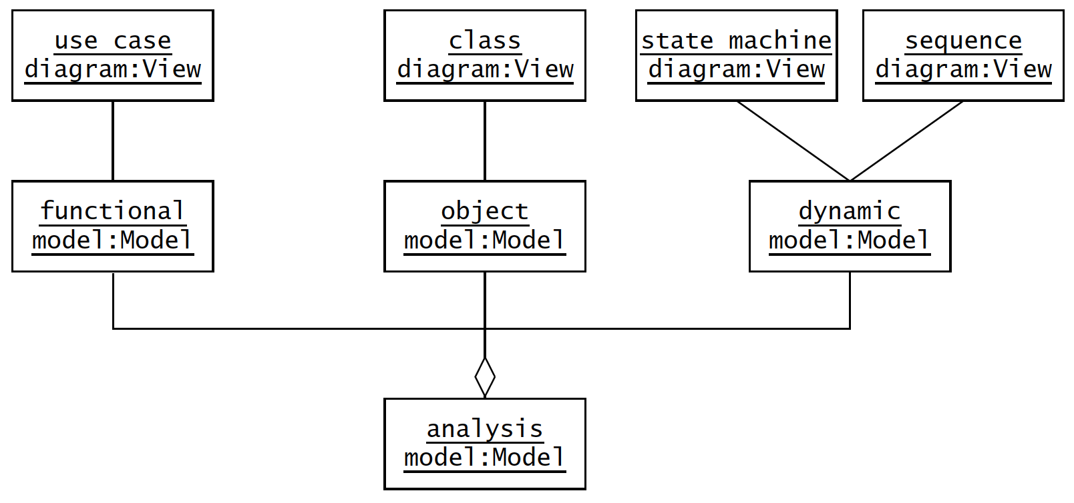
Analysis model

Slide 47
Analysis concepts
Analysis object models and dynamic models
Object model – system, properties and relationships (class diagram)
Dynamic model – behavior of system (sequence diagram, state machine)

Slide 48
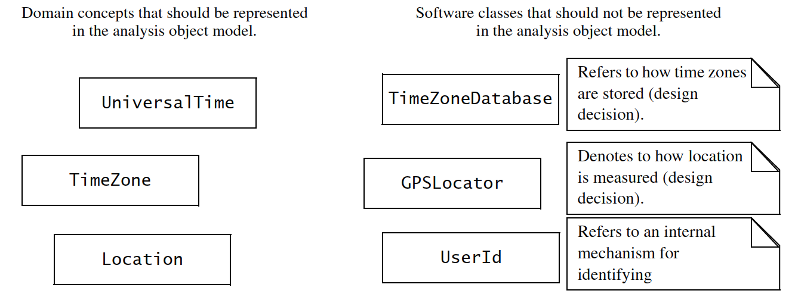
Analysis concepts
Classes

Slide 49
Analysis concepts
Entity, boundary, and control objects
Entity – objects
Boundary – interactions between actors and system
Control – realising use cases

Slide 50
Analysis concepts
Generalisation and specialisation
Generalisation – identify abstract concepts from lover-level ones
Specialisation – identify more specific concepts from high-level one

Slide 51
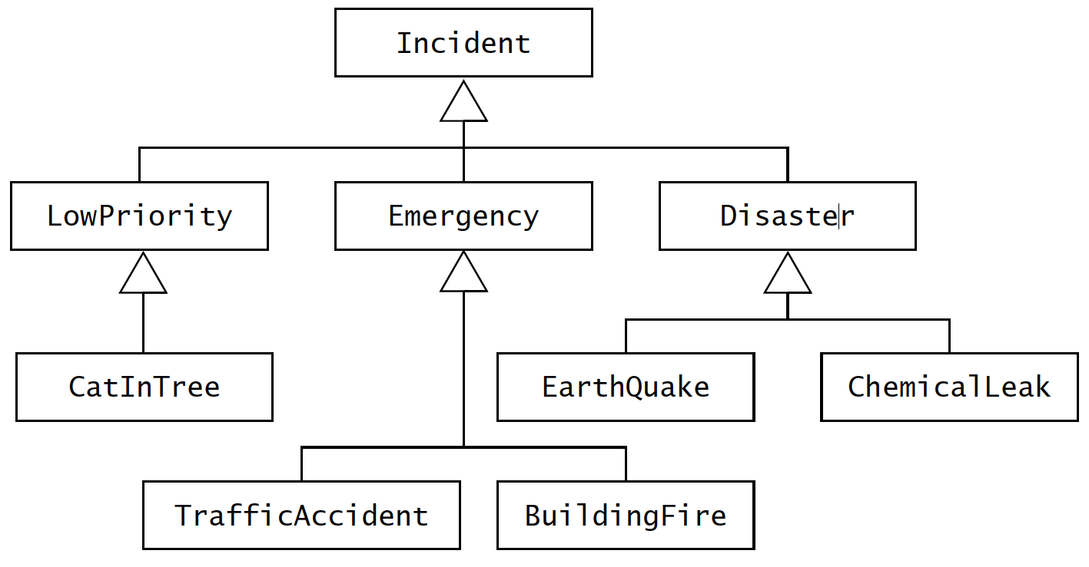
Analysis concepts
Generalisation and specialisation

Slide 52
Analysis activities
Identifying Entity Objects
Identifying Boundary Objects
Identifying Control Objects
Mapping Use Cases to Objects with Sequence Diagrams
Modeling Interactions among Objects with CRC Cards
Identifying Associations
Identifying Aggregates
Identifying Attributes
Modeling State-Dependent Behavior of Individual Objects
Modeling Inheritance Relationships
Reviewing the Analysis Model

Slide 53
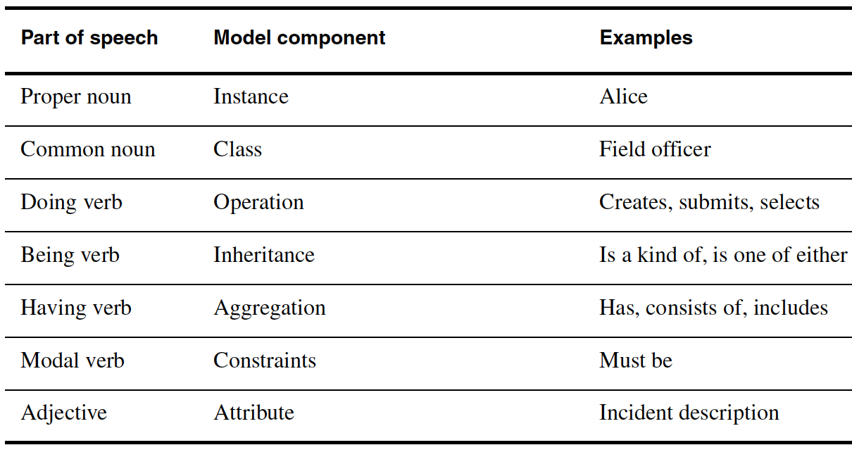
1. Identifying entity objects

Slide 54
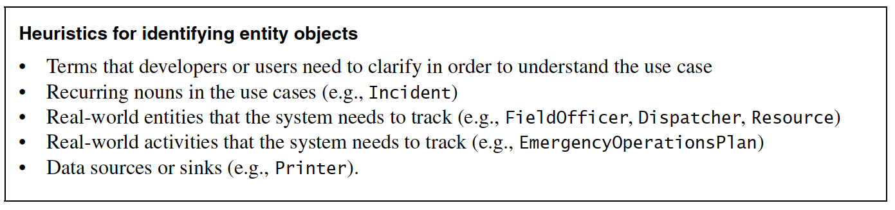
Identifying entity objects

Slide 55
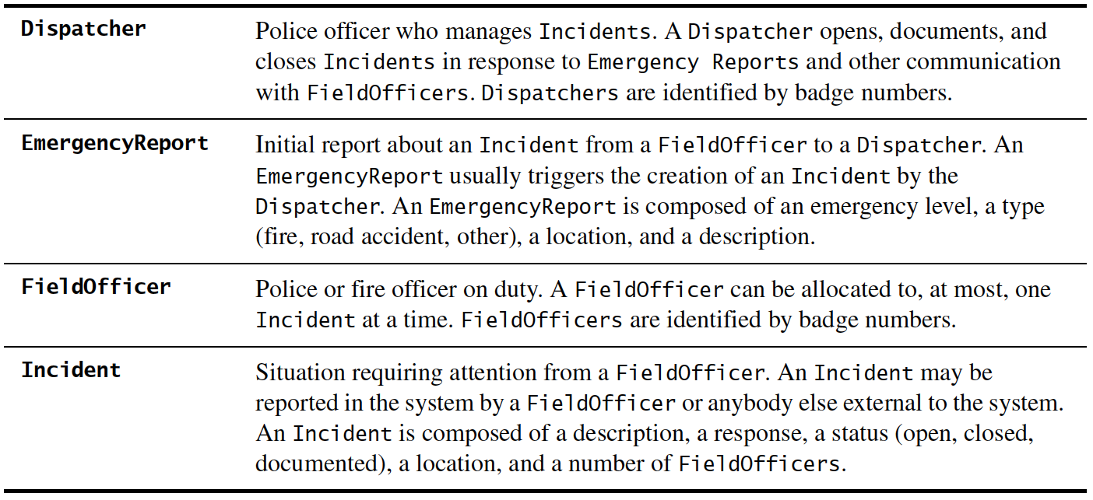
ReportEmergency use case

Slide 56
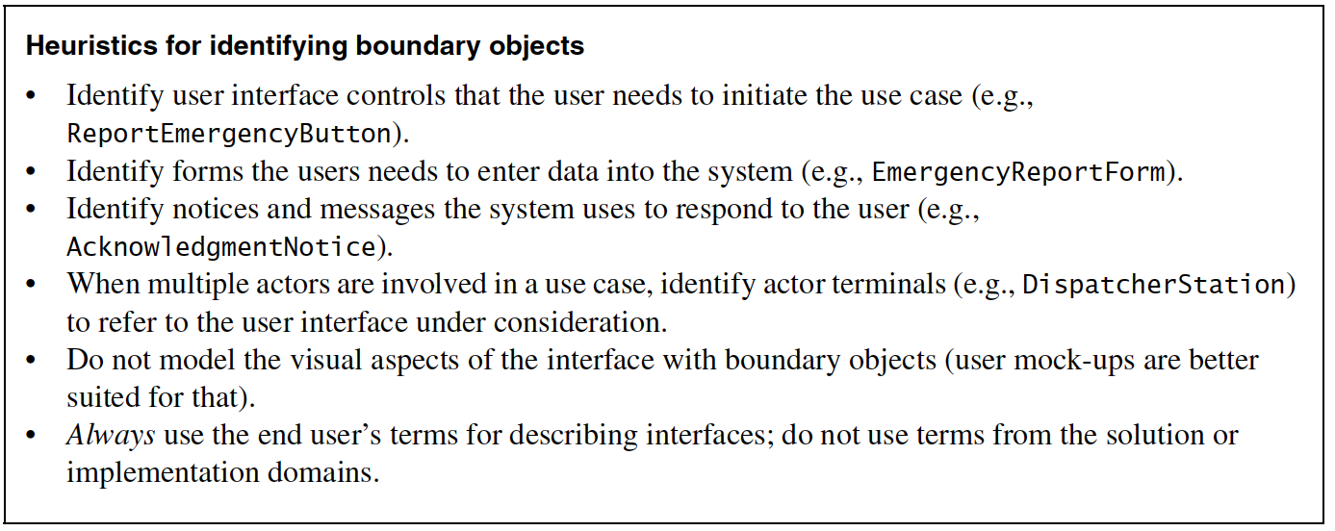
2. Identifying boundary objects

Slide 57
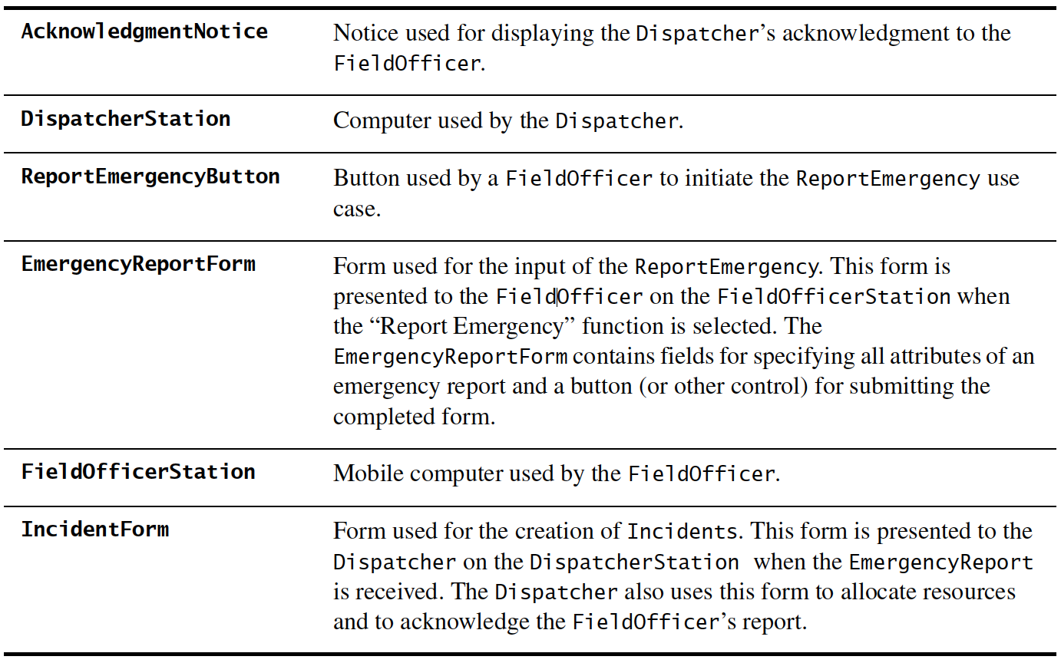
ReportEmergency boundary objects

Slide 58
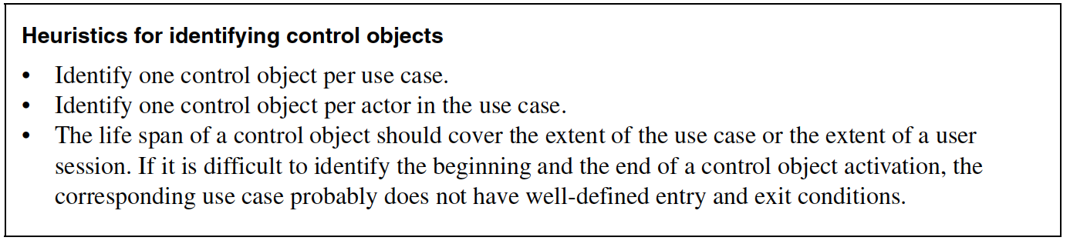
3. Identifying control objects

Slide 59
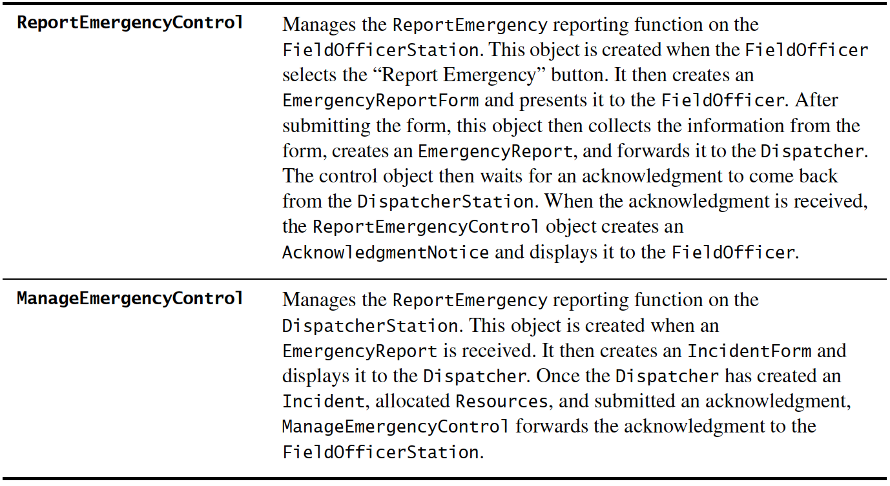
Identifying control objects

Slide 60
USE CASES
Define functional and operational requirements of the system by defining a scenario of usage.
Provide a clear and unambiguous description of how the end-user and system interact with one another.
Provide a basis for validation testing.

Slide 61
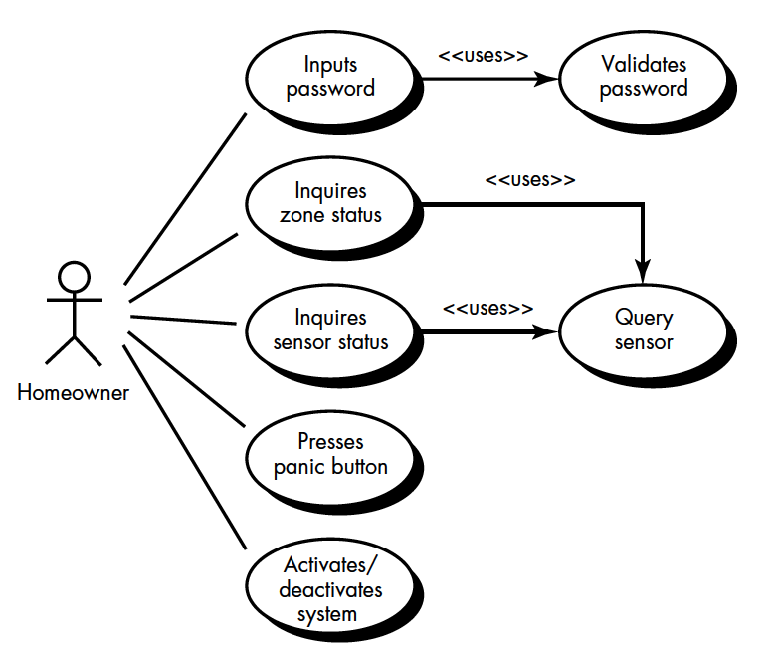
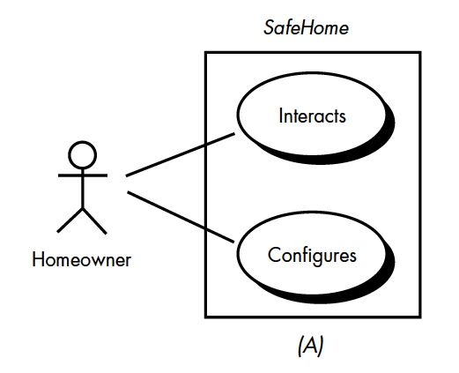
USE CASES

Slide 62
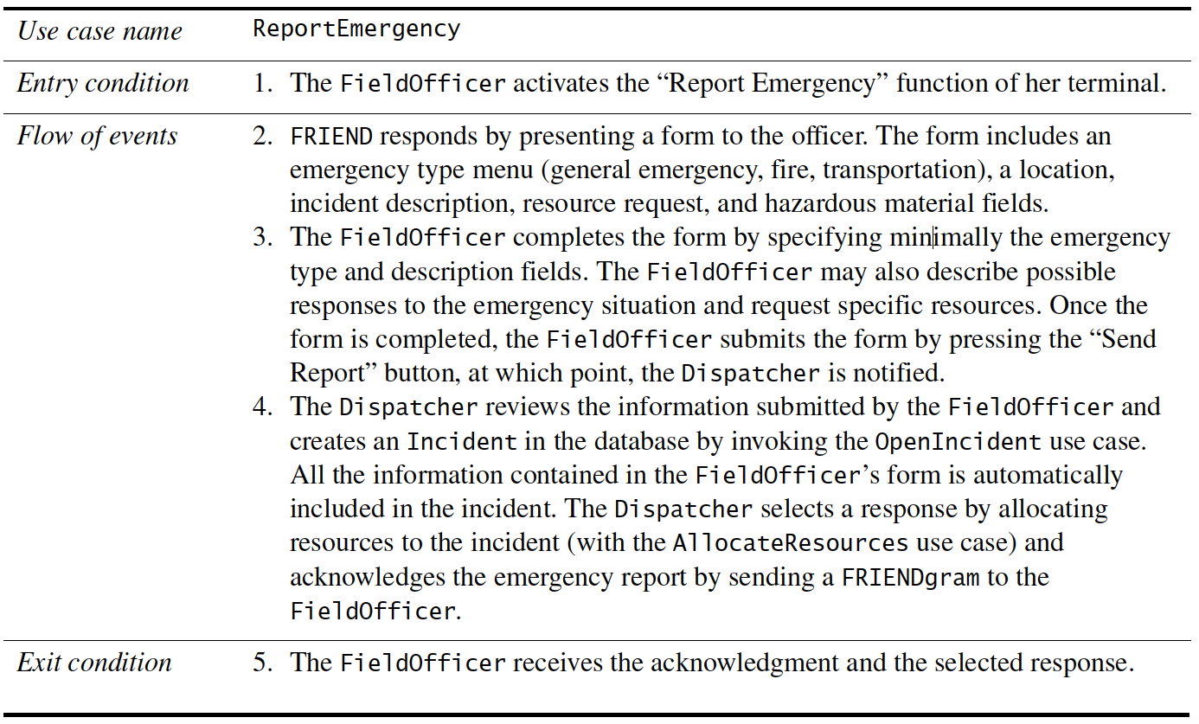
USE CASES

Slide 63
Activity diagrams
Representing flow of process graphically, has very high semantics
Elements: action nodes, control nodes, and object nodes.
Control notes – 3 types:
initial and final (activity final and flow final), (fig. 5-28)
decision and merge (fig. 5-29, fig. 5-30), and
fork and join (fig. 5-31)
Activity diagram with objects (fig. 5-32)

Slide 64
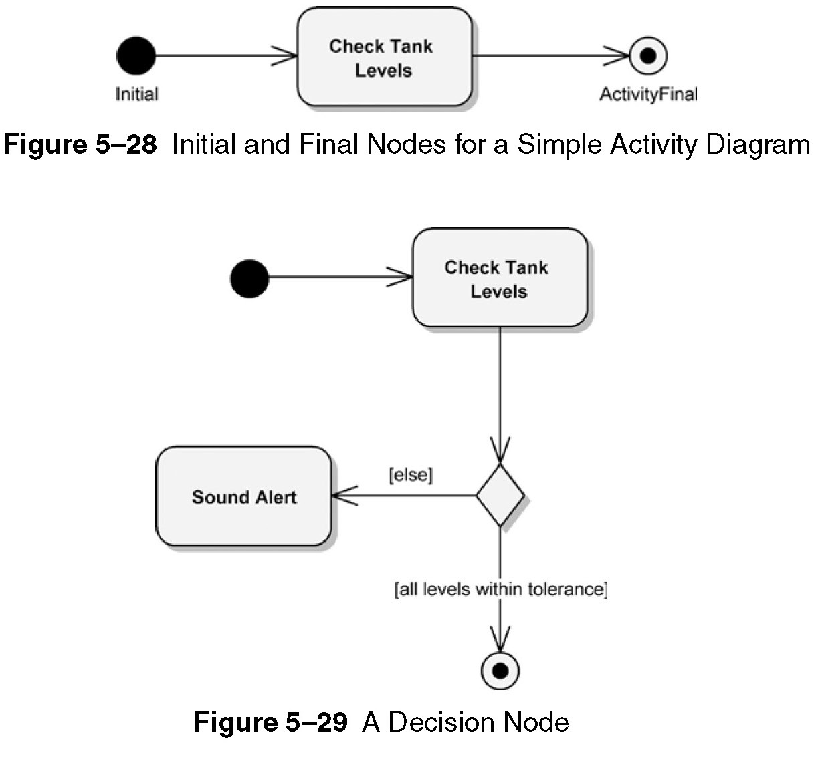

Slide 65
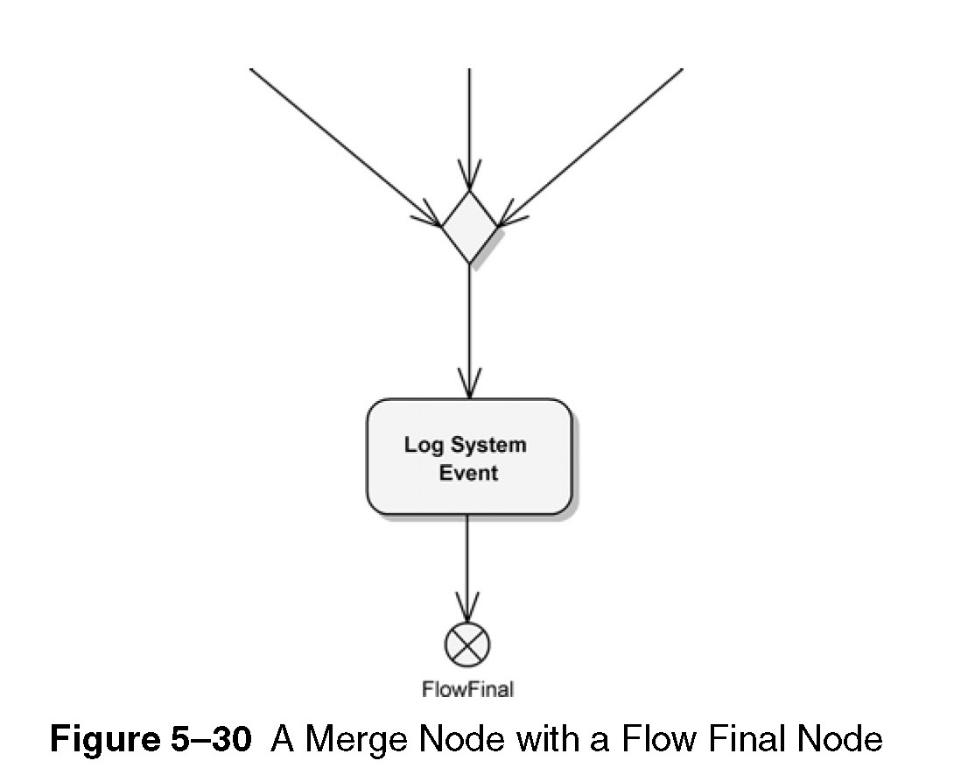

Slide 66
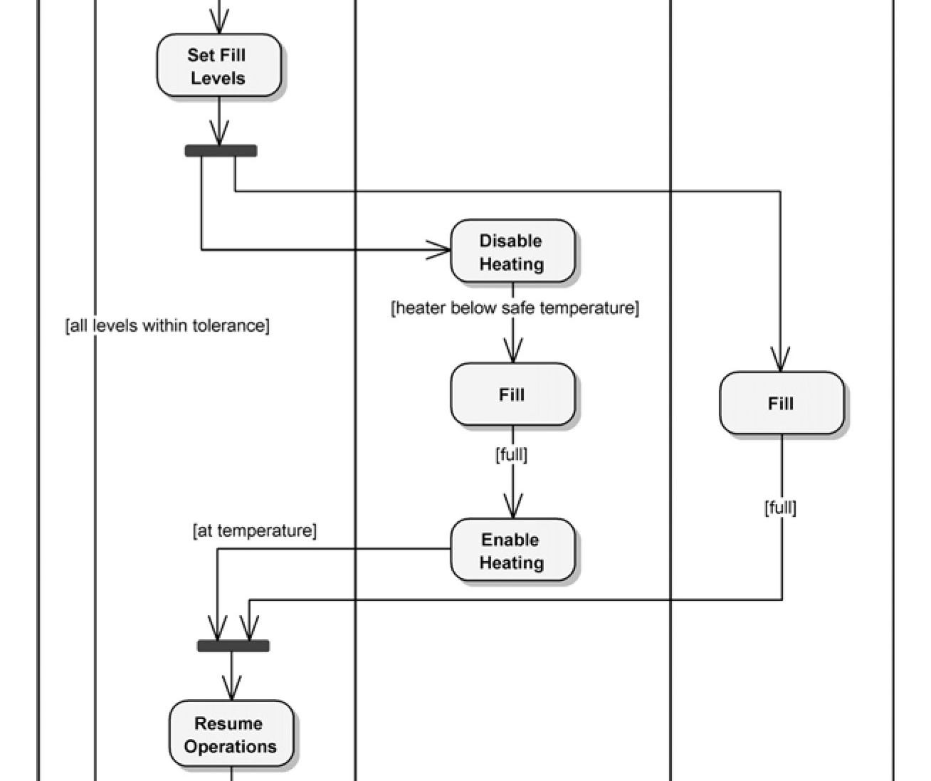

Slide 67
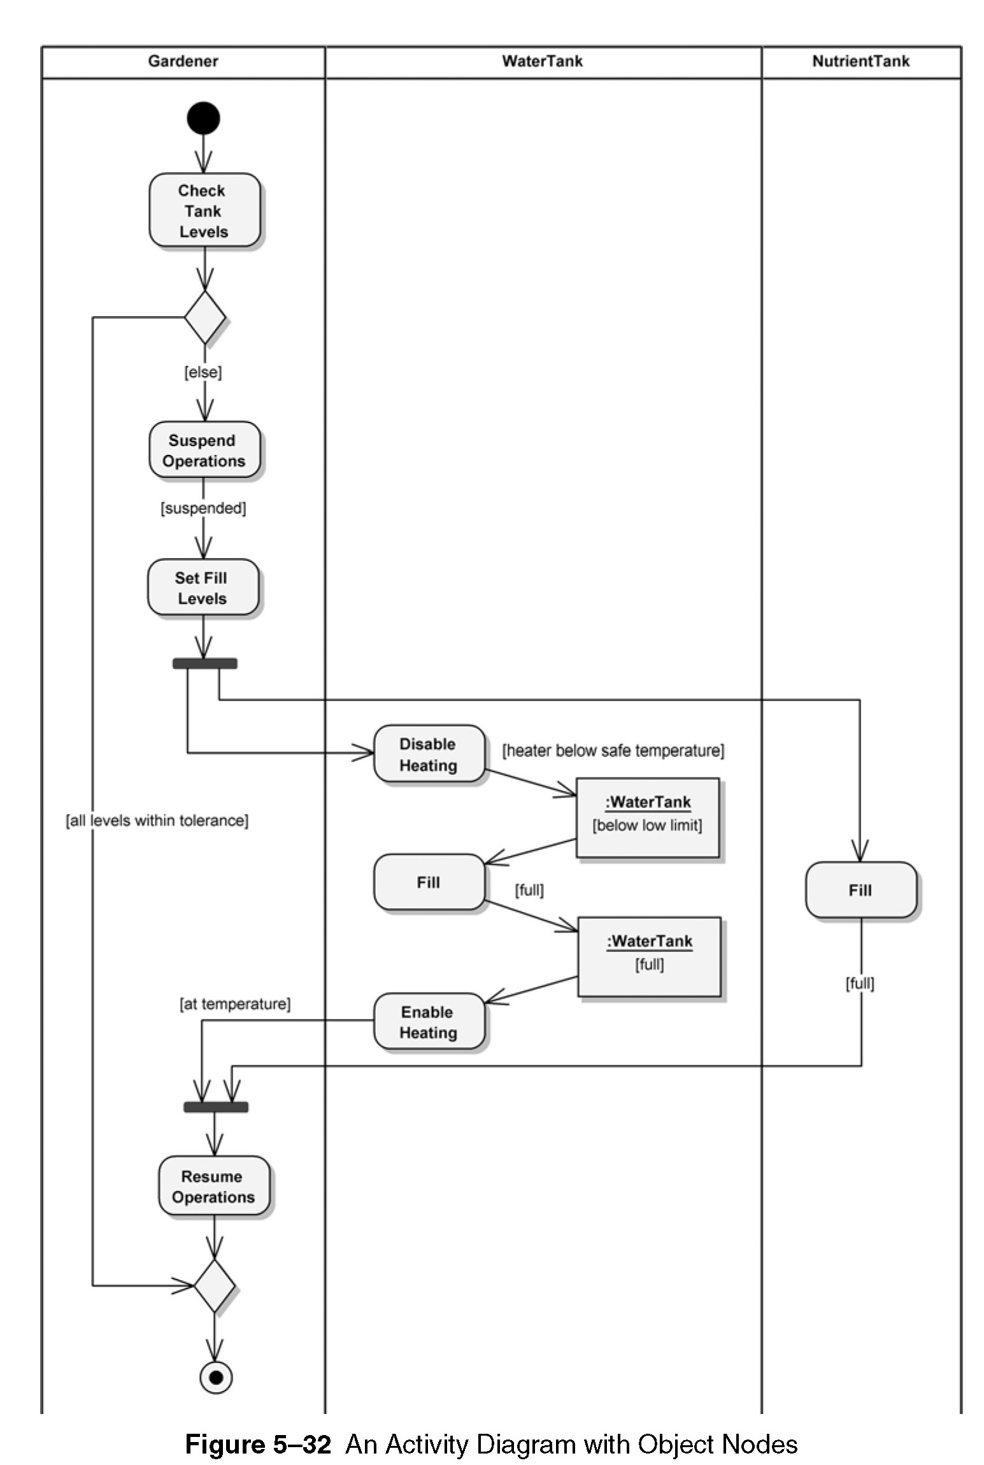

Slide 68
4. Mapping USE CASES to objects with sequence diagrams
Shows how the behavior of a use case is distributed among its participating objects
Columns of objects
Left most column – actor that initiates the use case
Horizontal arrows – messages
Time proceeds vertically

Slide 69
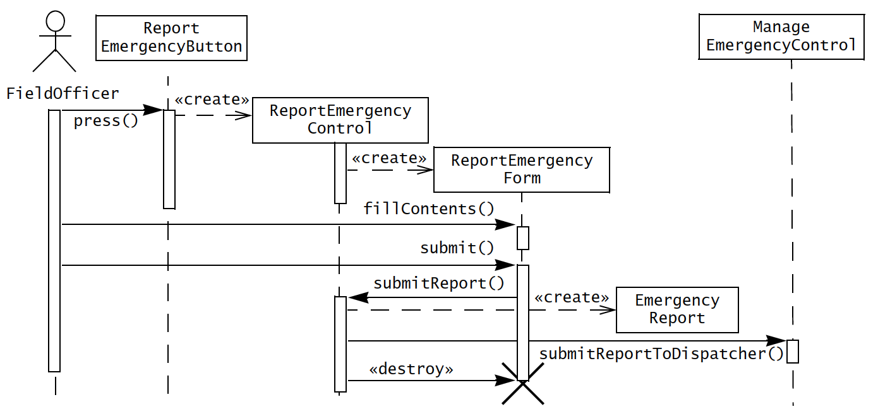
sequence diagram for report emergency

Slide 70
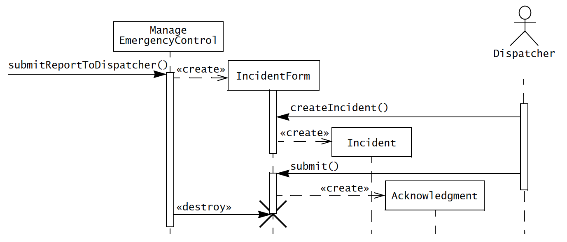
sequence diagram for report emergency

Slide 71
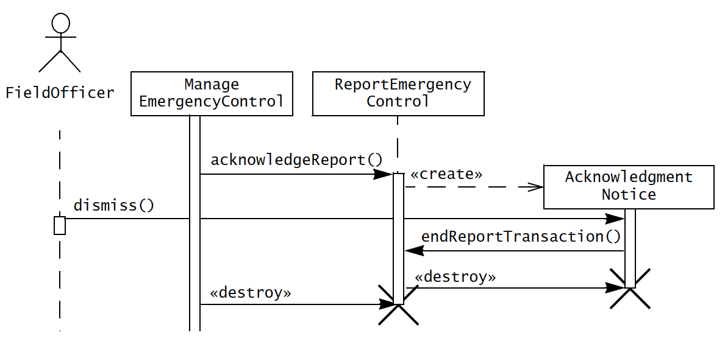
sequence diagram for report emergency

Slide 72
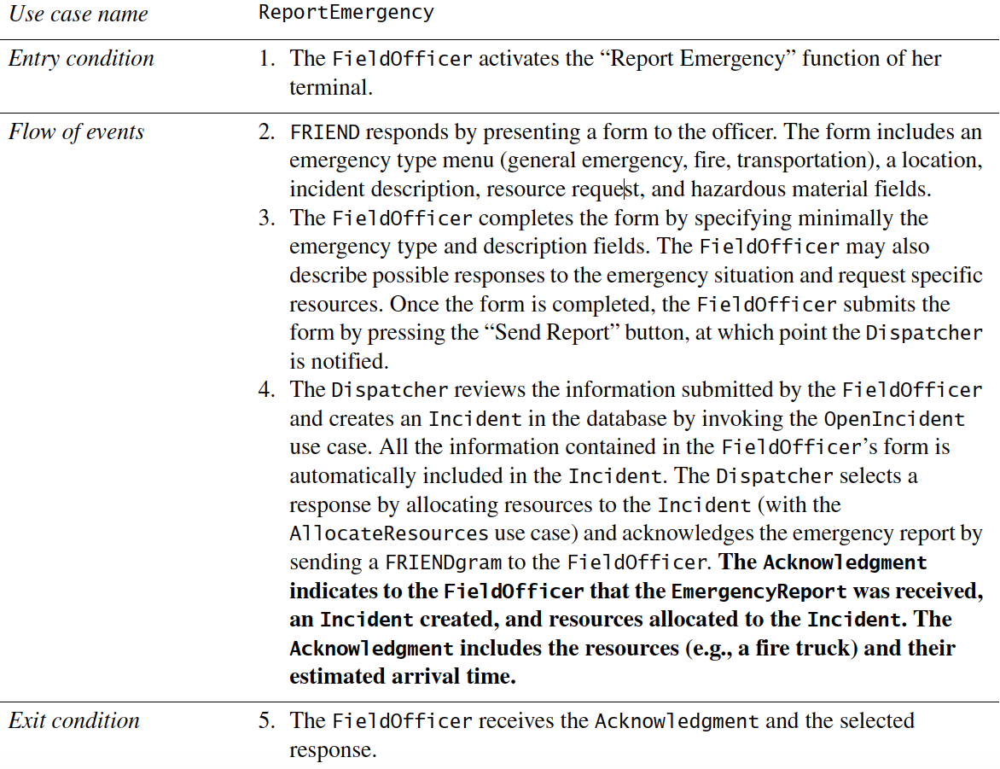

Slide 73
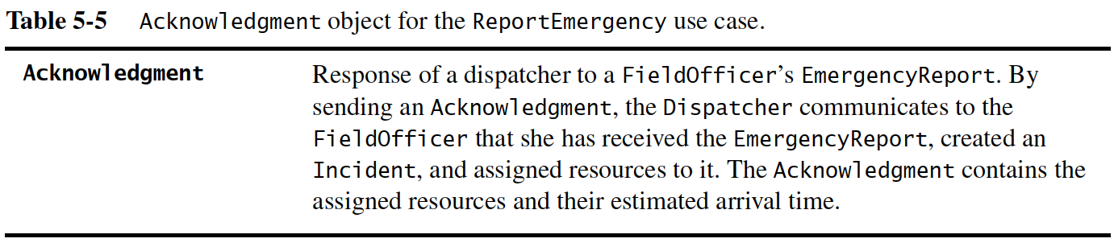

Slide 74
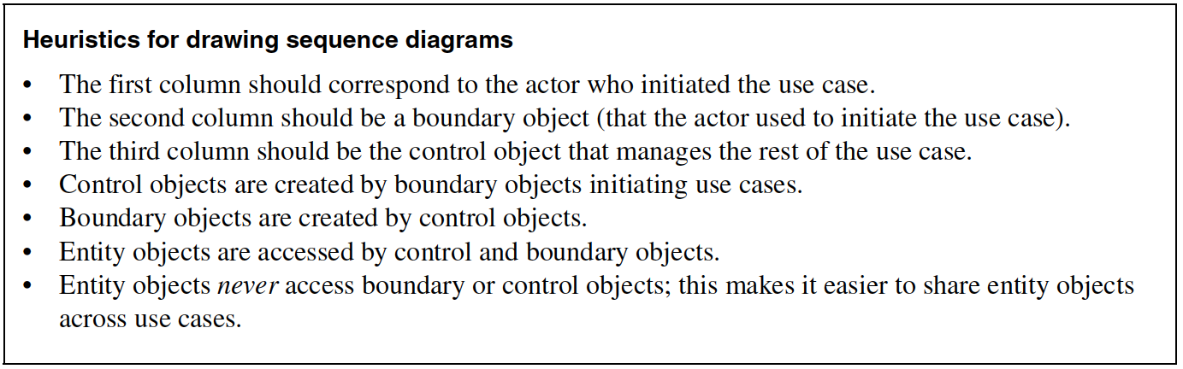
Mapping USE CASES to objects with sequence diagrams

Slide 75
5. Mapping interactions among objects with crc cards
Class-responsibility-collaborator modeling
Classes – have characteristics: retained information, needed services, multiple attributes, common attributes, common operations, essential requirements
Class types:
device class (e.g. sensor)
property class (e.g. rating)
interaction class (e.g. purchase, license, acquisition)

Slide 76
Mapping interactions among objects with crc cards
Responsibilities (attributes and operations)
Attributes – stable features
Operations – processing narrative
Five guidelines
System intelligence should be evenly distributed
Each responsibility should be stated as generally as possible
Information and behavior related to it should reside within the same class
Information about one thing should be localised with single class, not distributed across multiple classes.
Responsibilities should be shared among related classes, when appropriate.

Slide 77
Mapping interactions among objects with crc cards
Collaborations fulfill their responsibilities in one of two ways;
A class can use its own operations to manipulate its own attributes
A class can collaborate with other classes

Slide 78
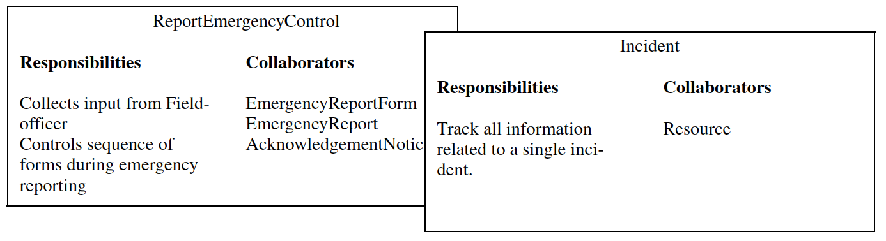
crc cards

Slide 79
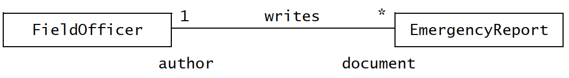
6. Identifying associations
An association shows relation between two or more classes.
Have several properties;
Name
Role
Multiplicity

Slide 80
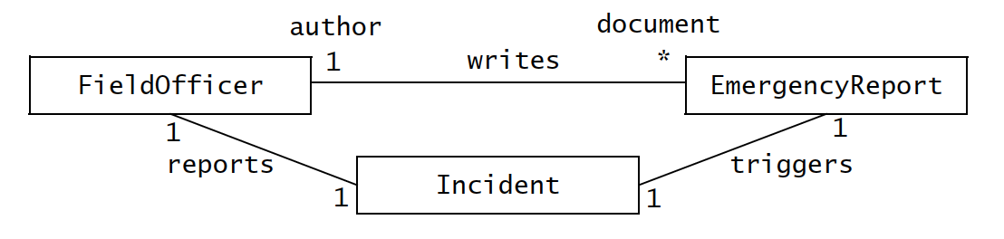
Eliminating redundant association
Redundant associations should be removed. e.g.

Slide 81
7. Identifying aggregates
Aggregation – denotes whole-part relationship
The diamond part – represents whole
Two types of aggregation
Composition aggregation
Shared aggregation

Slide 82
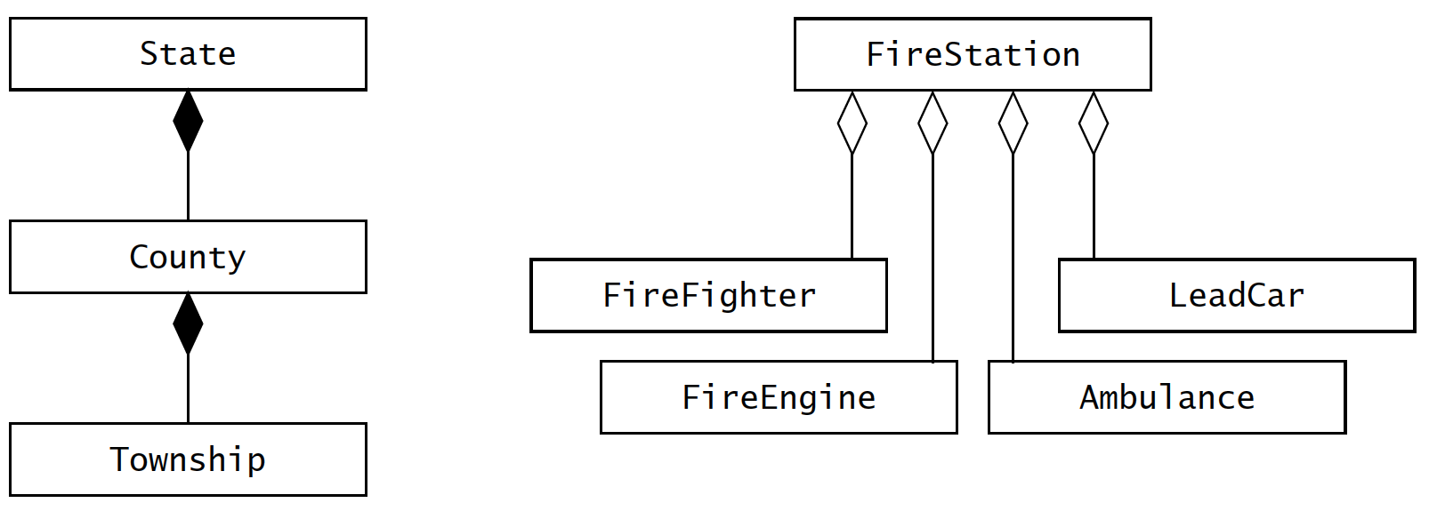
Two types of aggregates

Slide 83
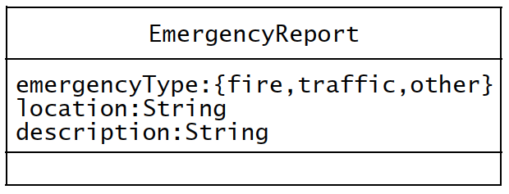
8. Identifying attributes
Attributes – properties of individual objects, least stable part
Properties are different to attributes!
First identify as many associations as possible before identifying attributes
Attributes have;
Name
Brief description
Type

Slide 84
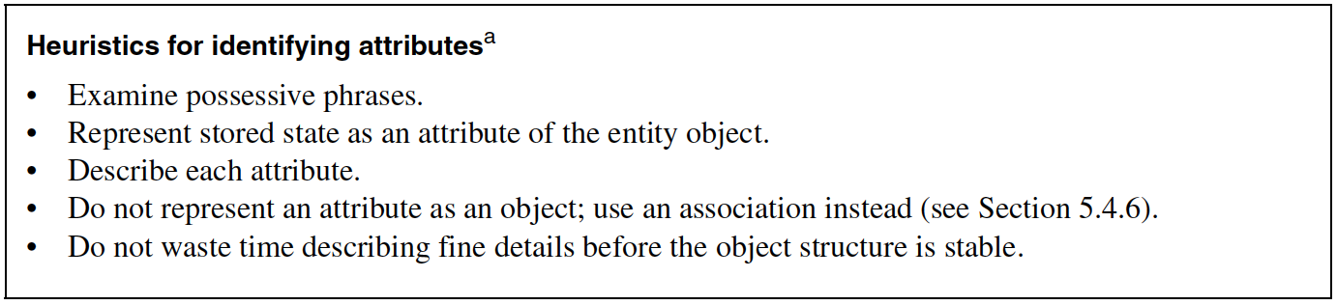
8. Identifying attributes

Slide 85
9. Modeling state-dependent behavior of individual objects
Sequence diagrams - distribute behavior across objects
Sequence diagrams - represent the behavior of the system from the perspective of a single use case.
State machine diagrams - represent behavior from the perspective of a single object
By modeling state change upon certain event, enables a developer to detail use cases.

Slide 86
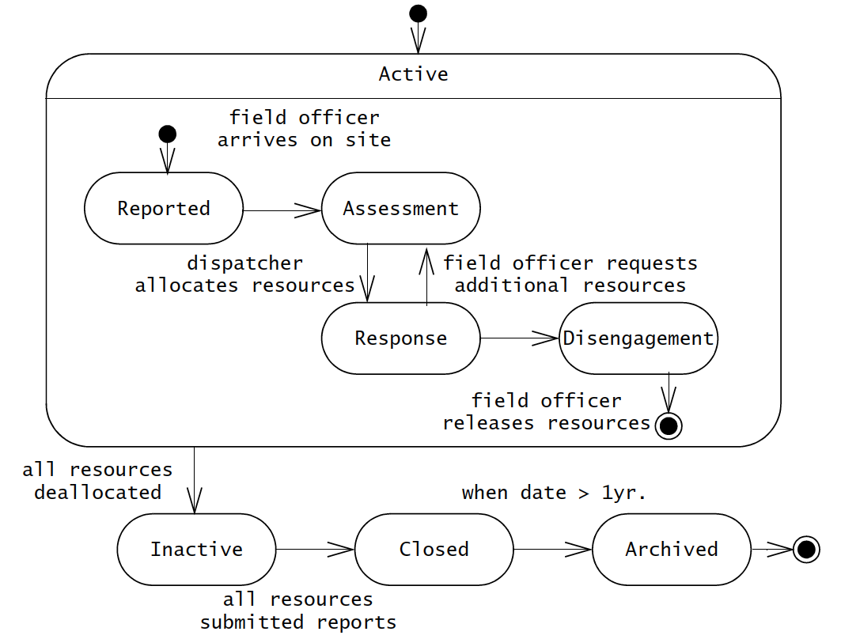
9. Modeling state-dependent behavior of individual objects

Slide 87
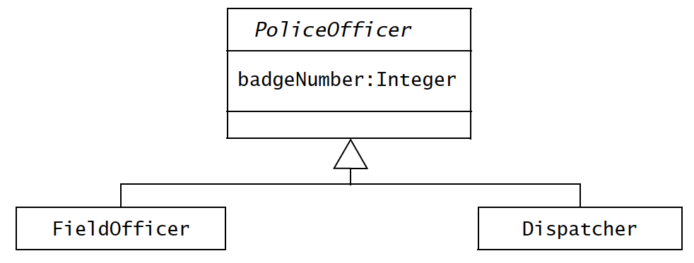
10. Modeling inheritance relationships between objects

Slide 88
11. Reviewing the analysis model
Analysis model is build incrementally and iteratively.
When number of changes become minimal in iterations, then the model is stable.
Need to look for a model that is
Correct
Complete
Consistent
Realistic

Slide 89
Class diagrams
Class notations (fig. 5-33)
Set of attributes, methods
Detailed attribute and operation specification
Abstract class – has no instances (italicize the name) (fig. 5-34) – FoodItem
Subclass (Tomato) inherits the abstract class
Content (has-a relationship)
Class relationship may contain multiplicity

Slide 90
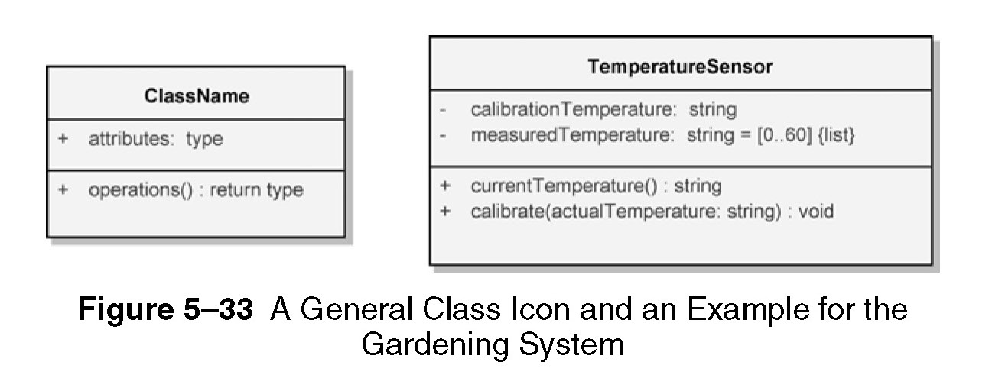
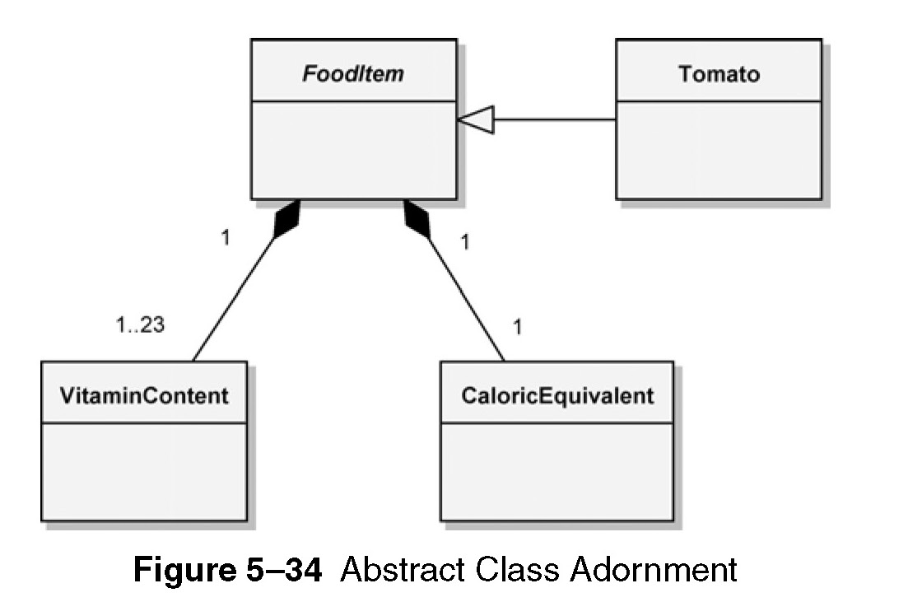

Slide 91
Class diagrams
Class relationships (fig. 5-35)
Association
Generalisation
Aggregation
Composition
Classes can be used to represent physical containment (fig. 5-36)

Slide 92


Slide 93


Slide 94
Class diagrams
Advanced concepts
Template classes (fig. 5-37)
Visibility of elements (fig. 3-38)
Public ( + )
Protected ( # )
Private ( - )
Package ( ~ )
Association end names and qualifiers (roles played by classes), (fig. 5-39)

Slide 95



Slide 96


Slide 97
Class diagrams
Advanced concepts
Constraints – can be specifies for classes and their relationships, (fig. 5-40)
Association classes and notes, (fig. 5-41)

Slide 98


Slide 99


Slide 100
Object diagrams
Two elements
Objects, (fig. 5-75)
Relationships, (fig. 5-76)
May use end names and qualifiers

Slide 101



Slide 102

System design activities

Slide 103
Addressing Design Goals
Design goals - reliability, fault tolerance, security, modifiability etc.
Selecting a hardware config. and a platform – use deployment diagrams
Allocating objects and subsystems to nodes – revise the deployment diagrams using component diagrams
Identifying and storing persistent data – refine the component diagrams for data storage

Slide 104
Addressing Design Goals
Identifying persistent objects – determine which object is persistent to the users e.g. Sensor
Selecting a storage management strategy – flat fles, relational databases, object-oriented databases. Ref. to table 7-7.
Providing access control – detail authentication and authorisation, global access table (actor, class, operation), use access control lists (actor, operation), capability associates (class, operation) paired with an actor

Slide 105

Addressing Design Goals

Slide 106

Addressing Design Goals
Designing the global control flow
Procedure-driven control flow
Event-driven control flow
Threads
Identifying services

Slide 107
Addressing Design Goals
Identifying boundary conditions
Initial configuration
Start-up and shutdown
Exception handling (hardware failure, changes in the operating environment, software fault etc.)

Slide 108
System design activities

Slide 109

Subsystems and classes
Decompose system into independent systems
Abstract away one class from rest of the subsystems
Recursively apply this technique

Slide 110

Components and dependencies
Use component diagrams to represent different subsystems and dashed arrow to indicate dependencies

Slide 111

Services and components
Components provide different services through interfaces

Slide 112
Cohesion and coupling
Cohesion – number of dependencies between components within a subsystem
Coupling – number of dependencies between two subsystems

Slide 113

Cohesion and coupling
One of the design rule is to minimise coupling and enhance cohesiveness

Slide 114

Cohesion and coupling

Slide 115

Cohesion and coupling

Slide 116

Cohesion and coupling

Slide 117

Layers and partitions
Hierarchical decomposition of a system results into an ordered set of layers.

Slide 118
Architectural styles
Subsystems can be organised in different ways.
An architectural style provides a systematic method to decompose a system. It includes;
System decomposition,
global control flow,
handling boundary conditions, and
intersubsystem communications

Slide 119
Architectural styles
Repository
Model-view-controller
Client-server
Peer-to-peer
Four-tier
Pipe and filter

Slide 120
Repository architectural style
Subsystems access and modify a single data structure called the central repository.
Subsystems are relatively independent, interact through the repository.
Repository may trigger events to control flow
Used for – database management systems, centralised global control flow, constantly changing complex data processing tasks etc.

Slide 121

Repository architectural style

Slide 122

Model-view-controller
Three subsystems
Model – contains domain knowledge, computation models etc.
View – represent output to the user
Controller – manage sequence of interactions with the user
Useful where input/output representation changes are required

Slide 123

Model-view-controller

Slide 124

Client-server
Server – provides services to instances of other subsystems called clients
Clients – request for service via RPC or object broker such as CORBA, Java RMI, HTTP etc.

Slide 125


Peer-to-peer

Slide 126

Three-tier
Interface layer – includes all boundary objects that deal with the user
Application logic layer – includes all control and entity objects
Storage layer – realises storage, retrieval,a and query of persistent objects

Slide 127

four-tier

Slide 128


Pipe-filter
Filters – subsystems, can run concurrently
Pipes – associations between them, provide synchronisation

Slide 129
Object design
Includes four groups of activities
Reuse – off-the-shelf or legacy subsystems, classes
Interface/service specification – identifying subsystem services
Restructuring of object model – for code reuse, high cohesiveness, lower coupling
Optimisation of object model – meet performance requirements

Slide 130


Slide 131


Slide 132
reuse
Reuse existing objects/classes
Inheritance – decouples classes using superclasses. Strong coupling along the inheritance hierarchy.

Slide 133

reuse

Slide 134

reuse

Slide 135

reuse

Slide 136
reuse
Delegation – an alternative to inheritance that should be used when reuse is desired.
A class delegates another one if it implements an operation by sending message to another class.
Extensibility – extend the functionality (e.g. containsValue can extend function of containsKey())
Subtyping – MySet does not inherit from Hashtable

Slide 137
Design patterns
Design patterns – template solutions for a range of recurring problems. Contain;
Name – unique identifier
Problem description – situation where the pattern is used
Solution – set of collaborating classes and interfaces
Consequences – trade-offs, alternatives

Slide 138

Design patterns

Slide 139
Design patterns
Example – in previous example, Adapter pattern, the participating classes are;
Client class – accesses the pattern
Pattern interface – realised by abstract class or an interface
Implementor class – provides lower-level behavior
Extender class – provides a different implementation or extended behavior of the pattern

Slide 140

Design patterns

Slide 141
Reuse activities
Selecting design patterns and components;
To adapt to changes, design patterns help by reducing amount of time and effort.

Slide 142

Selecting patterns

Slide 143

Selecting patterns

Slide 144
Identifying and adjusting application frameworks
Application frameworks – reusable partial application that can be specialised to produce custom applications.
Different than class libraries, frameworks are trageted to particular technologies such as data processing, cellular communications, user interfaces, real-time components etc.

Slide 145
Framework classification according to their position in the software dev. process
Infrastructure frameworks – operating systems, debuggers, communication protocols, user interfaces etc.
Middleware frameworks – used to integrate existing distributed applications and components. E.g. Microsoft’s MFC, DCOM, Java RMI, WebSphere, WebLogic, Corba, transactional databases etc.
Enterprise application frameworks – application specific, e.g. JavaEE

Slide 146

Framework example: WebObject

Slide 147
Managing reuse
Advantages
Lower development effort
Lower risk
Widespread use of standard terms
Increased reliability
Challenges
Not invented here (NIH) syndrome
Process support
Training

Slide 148
Interface specification
Identify missing attributes and operations – examine each subsystem service and each analysis object. Identify missing operations and attributes that are needed to realise the subsystem service.
Specify visibility and signatures – define visibility, no. of parameters etc.
Specify contracts – services provided by each object, conditions that must be met to invoke the services, return values

Slide 149
Interface specification concepts
Class Implementor, Class Extender, and Class User
Types, Signatures, and Visibility
Contracts: Invariants, Pre-conditions, and Post-conditions
Object Constraint Language
OCL Collections: Sets, Bags, and Sequences
OCL Qualifiers: forAll and exists

Slide 150

Mapping concepts
Model transformations
Refactoring
Forward engineering
Reverse engineering

Slide 151

Model transformation
Applied to object model and results in another object model.

Slide 152

refactoring
To improve source code readability or modifiability without changing its behavior.

Slide 153

Forward engineering

Slide 154
Reverse engineering
Mapping source code elements back to a set of model elements.
CASE tools help build an approximate model.
Approximate – because forward engineering may lose information e.g. associations are turned into collections of references.

Slide 155
Transformation principles
Each transformation must address a single criteria.
Each transformation must be local.
Each transformation must be applied in isolation to other changes.
Each transformation must be followed by a validation step.

Slide 156
transformations
Transform models
Optimising the object design models i.e. class models
Mapping associations to collections
Mapping operations contracts to exceptions
Mapping the class model to a persistent storage schema

Slide 157
Optimising the object design model
Optimising access paths
Repeated association traversals – frequent operations between two objects through other objects must be simplified by creating an association.
“Many” associations – decrease search time by reducing the “many” to “one”
Misplaced attributes – reduce excessive modeling, calling vs. hosting classes

Slide 158

Optimising the object design model
Collapsing objects

Slide 159

Optimising the object design model
Delaying expensive computations

Slide 160
Optimising the object design model
Caching the result of expensive computations
If some values are repeatedly access after computation, its better to keep them in cache.

Slide 161

Mapping associations to collections

Slide 162

Mapping associations to collections

Slide 163

Mapping associations to collections

Slide 164

Mapping associations to collections

Slide 165

Qualified associations

Slide 166

Association classes

Slide 167
Mapping contracts to exceptions
Contracts help in;
Checking preconditions
Checking postconditions
Checking invariants
Dealing with inheritance

Slide 168

Mapping contracts to exceptions
Example

Slide 169


Slide 170


Slide 171

Mapping contracts to exceptions

Slide 172
Discussion on Nepali System/Software Development Practices

